Slide 1

Choices under uncertainty and intertemporal choices
Dr.R.Gayathri
Faculty, SoM
SASTRA

Slide 2
Intertemporal choices
Intertemporal choices relate to decisions involving trade-offs between costs and benefits occurring in different time periods.
Governments, firms and individuals face decisions on a frequent and ongoing basis, for example: investing in roads, schools and hospitals; building a new factory or launching a new product; buying a new car, spending on a vacation, or joining a health club.

Slide 3
Discounted Utility Model (DUM)
Although Adam Smith was the first economist to discuss the importance of intertemporal choice as far as the wealth of nations was concerned, it was Rae who essentially provided a psychological foundation for a theory of intertemporal choice.
Rae (1834) identified ‘the effective desire for accumulation’
as being the key psychological factor determining a society’s decisions to save and invest, which in turn determined a country’s rate of economic productivity and growth.

Slide 4
Rae also identified four psychological factors that either promoted or inhibited this desire and which varied across different societies. The two promoting factors were:
1 The bequest motive – to accumulate resources for one’s descendants.
2 The propensity to exercise self-restraint – this involves the intellectual capacity to foresee probable future outcomes of decisions, and the willpower to put long-term interests ahead of short-term ones.
The two inhibiting factors described by Rae were:
1.The uncertainty of human life – there is no point in saving for the future if it is unlikely that we will have much of one. Rae summed this up by saying: When engaged in safe occupations, and living in healthy countries, men are much more apt to be frugal, than in unhealthy, or hazardous occupations, and in climates pernicious to human life .
2. The urge for instant gratification exacerbated by the prospect of immediate consumption – Rae again expresses this in vivid terms:
The actual presence of the immediate object of desire in the mind by exciting the attention, seems to rouse all the faculties, as it were, to fix their view on it, and leads them to a very lively conception of the enjoyments which it offers to their instant possession

Slide 5

Samuelson introduced the DUM in 1937. The DUM has nine primary features:
integration of new alternatives with existing plans;
utility independence;
consumption independence;
stationary instantaneous utility;
stationary discounting;
constant discounting;
independence of discounting from consumption;
diminishing marginal utility; and
positive time preference.

Slide 6
Anomalies
There are a large number of anomalies in the DUM: the ‘sign effect’; the ‘magnitude effect’; the ‘delay-speedup’ asymmetry; the preference for improving sequences; the ‘date/delay effect’; and violations of independence and preference for spread
The anomalies in the DUM should not be regarded as mistakes or errors in judgement. Instead, they imply that the model lacks both descriptive and normative validity.

Slide 7
Sign Effect – People discount gains more than losses, valuing future losses more heavily than future gains.
Magnitude Effect – Larger rewards are discounted less than smaller ones, meaning people are more patient for significant gains.
Delay-Speedup Asymmetry – People demand higher compensation to delay a reward than they are willing to pay to speed it up.
Preference for Improving Sequences – Individuals prefer outcomes that improve over time rather than those that decline.
Date/Delay Effect – Preferences for future rewards change depending on whether delays are framed as absolute dates or time differences.
Anomalies

Slide 8

Further developments
The next major development in the theory of intertemporal choice came from Böhm-Bawerk (1889). He, and later Pigou (1920), introduced the notion that people generally underestimate future wants, leading to a time preference pattern biased towards the present.
The final development before the introduction of the discounted utility model came from Irving Fisher (1930). He formalized much of the work outlined above, extending the Böhm-Bawerk framework of analysis in terms of using indifference curves to illustrate the relevant trade-offs. The concept of the marginal rate of substitution between current and future consumption was also applied; this depended both on time preference and diminishing marginal utility

Slide 9
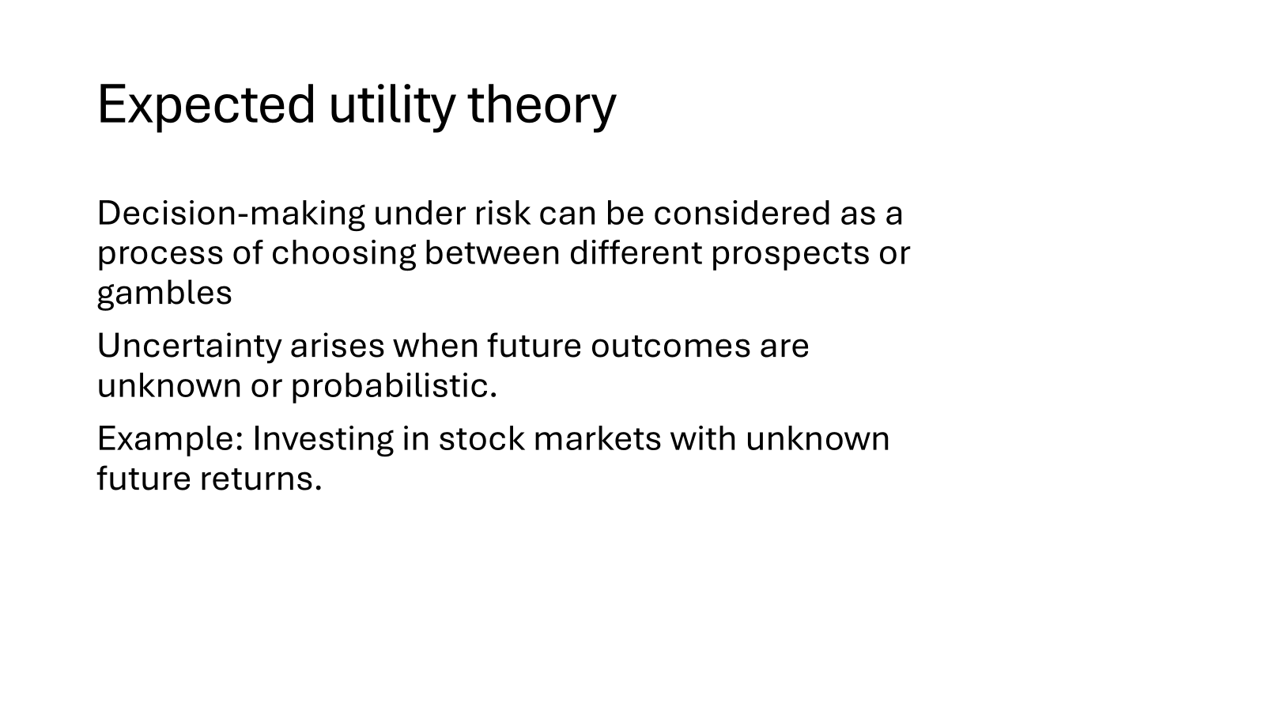

Slide 10
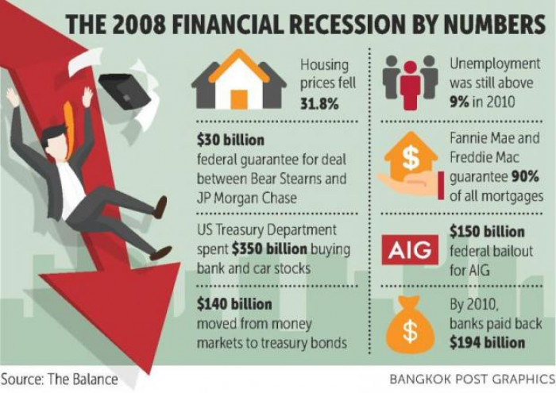

Slide 11
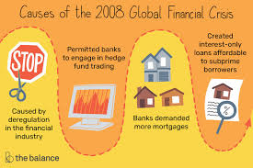
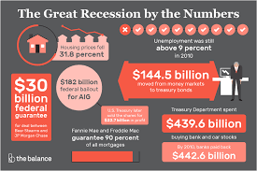
Financial crisis- 2008
Studies by John Coates (Coates and Herbert, 2008), a neuroscientist and former derivatives trader, indicate that uncertainty among financial traders causes the adrenal cortex in their brains to increase the output of cortisol, a stress-related hormone.

Slide 12
Expected Utility Theory (EUT)
Assumes individuals maximize expected utility.
Assumptions: Rationality, risk aversion, consistent preferences.
Example: Purchasing insurance to mitigate financial risk.

Slide 13
Limitations of EUT
Empirical studies show deviations from EUT.
People exhibit risk-seeking and risk-averse behavior inconsistently.
Example: Simultaneously buying lottery tickets and insurance.

Slide 14
Hyperbolic discounting
Hyperbolic discounting is a concept in behavioral economics that describes how people tend to prefer smaller, immediate rewards over larger, delayed rewards, even when waiting leads to a greater benefit. Geometric discounting, also known as hyperbolic or quasi-hyperbolic discounting
Time Inconsistency – Preferences change over time, meaning a decision that seems optimal now might not seem optimal in the future.
Present Bias – People disproportionately prefer immediate rewards over future ones, even if the future rewards are much larger
Declining Discount Rate – The further in the future a reward is, the less steeply it is discounted.
For example, people may heavily discount a reward they receive in a week compared to today, but they discount a reward in a year vs. a year and a week much less.

Slide 15

Prospect theory
Prospect theory belongs to the behavioral economic subgroup, describing how individuals make a choice between probabilistic alternatives where risk is involved and the probability of different outcomes is unknown.
This theory was formulated in 1979 and further developed in 1992 by Amos Tversky and Daniel Kahneman, deeming it more psychologically accurate in how decisions are made compared with expected utility theory.
Prospect theory says that investors value gains and losses differently. That is, if an investor is presented an investment option based on potential gains, and another based on potential losses, the investor will choose an investment where potential gains are presented.

Slide 16
A prospect consists of a number of possible outcomes along with their associated probabilities.
Prospect theory states that decision-making under risk involves two phases: editing and evaluation.
The editing process involves coding, combination, segregation, cancellation, simplification and detection of dominance.
The evaluation of prospects in PT involves four main principles: reference points, loss-aversion, diminishing marginal sensitivity and decision-weighting

Slide 17
Reference points
It is often assumed in analysis that the relevant reference point for evaluating gains and losses is the current status of wealth or welfare, but this need not be the case.
In particular, the relevant reference point may be the expected status rather than the current status,

Slide 18
Time preferences
Time preferences in behavioral economics refer to how individuals value rewards or outcomes at different points in time. In simple terms, it's about how much more people value something now compared to later—and how this affects their decisions.
People give stronger weight to payoffs that are closer to the present time. Leads to procrastination, impulsive decisions, and poor self-control.
Example: Knowing that saving for retirement is important but choosing to spend money today.

Slide 19

Marshmallow test
The "Marshmallow Test" is one of the most famous experiments in behavioral psychology and economics, originally conducted by Walter Mischel at Stanford University in the late 1960s.

Slide 20
The researcher told the child:“You can eat this marshmallow now, but if you wait until I come back (about 15 minutes), you’ll get two marshmallows.”
The experiment was used to study time preferences, self-control, and future-oriented behavior.
Findings
Some children ate the marshmallow immediately.
Others distracted themselves (sang, covered their eyes, etc.) and waited for the second marshmallow.
Follow-up studies showed that children who were able to delay gratification:
Performed better academically (e.g., higher SAT scores)
Had better health
Had more stable relationships
Showed better emotional regulation

Slide 21
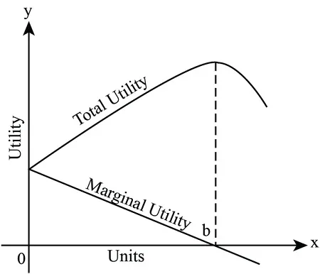
Marginal Utility – Classical vs. Behavioral View
Classical View: Diminishing Marginal Utility – Each additional unit of consumption adds less to total utility.
Behavioral Perspective: People don’t always perceive marginal changes rationally.
Sensitivity to gains/losses is relative to a reference point (Prospect Theory).
Example:₹1000 bonus feels great when earning ₹10,000/month, less so at ₹1,00,000/month.

Slide 22
Decision Weights
The decision weight is a function of the probability of the outcome. This decision-weighting function reflects the empirical regularity that people overweight certain events relative to near-certain events and overweight low-probability events.
Prospect theory incorporates non-linear weighting of probabilities by applying decision weights to each potential outcome.

Slide 23
An example:
As the president of an airline company, you have invested $10 million of the company's money into a research project. The purpose was to build a plane that would not be detected by conventional radar. When the project is 90 percent completed, another firm begins marketing a plane that cannot be detected by radar. Also, it is apparent that their plane is much faster and far more economical that the plane your company is building.
The question is: should you invest the last 10 percent of the research funds to finish your radar-blank plane?
NO - It makes no sense to continue spending money on the project.
YES - As long as $10M is already invested, I might as well finish it.

Slide 24
Decision and Probability Weighting
Prospect theory incorporates non-linear weighting of probabilities, contrasting with expected utility theory’s linear approach.
Traditional View: People make choices based on expected utility.
E(U) = Probability × Outcome
Behavioral View (Prospect Theory):
- Overweight small probabilities (e.g., buying lottery tickets)
- Underweight large probabilities (e.g., ignoring health risks)

Slide 25
Income and Consumption
Permanent vs. Temporary Income Hypothesis (Behavioral Extension):
People consume based on perceived future income, but may irrationally spend windfalls.
Mental Accounting: People treat money differently based on its source or purpose.
E.g., Tax refund vs. salary → more likely to be spent than saved.

Slide 26
The Permanent Income Hypothesis (PIH) suggests that consumers base their spending on their expected long-term average income, or permanent income, rather than on their current, potentially fluctuating income.
Temporary or transitory income, which is unexpected and not expected to persist, is viewed as having a minimal impact on consumption.

Slide 27

In economics, a necessity refers to goods or services essential for survival or basic living, while a luxury is non-essential but desired, often for pleasure or status.
Necessities include items like food, shelter, and clothing, while luxuries can be things like designer handbags or expensive jewelry.

Slide 28
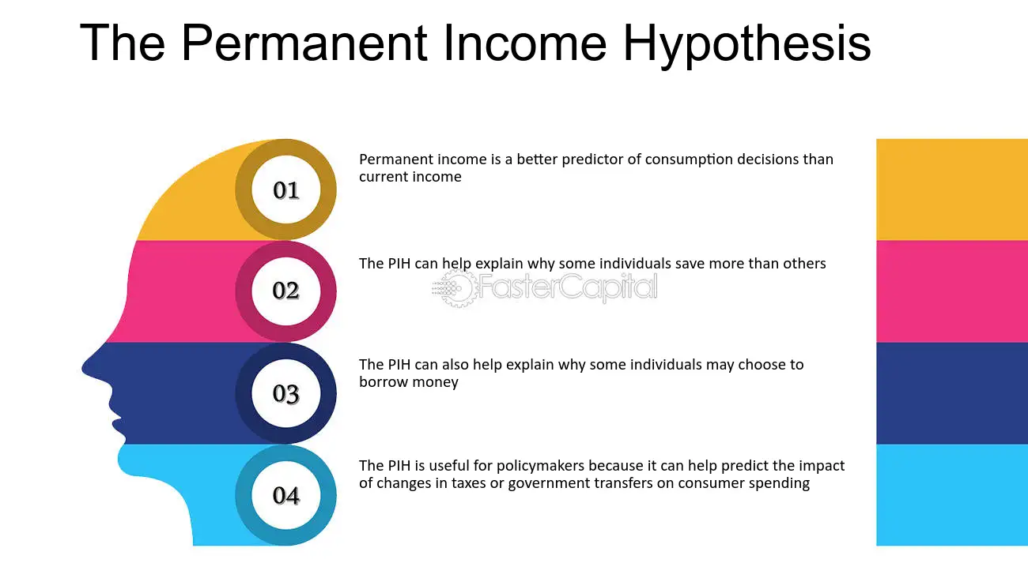

Slide 29

Role of the Government in Facilitating trade
The government plays a critical role in both domestic and international trade by creating an enabling environment, regulating practices, protecting interests, and promoting competitiveness.

Slide 30
Function | Government Role
Policy Making | FTPs, tariffs, trade rules
Infrastructure | Roads, ports, digital platforms
Financial Support | Subsidies, insurance, export finance
Negotiation | FTAs, trade blocs, WTO representation
Regulation & Protection | Anti-dumping, standards, environmental norms
Trade Promotion | Expos, missions, EPCs
Education & Training | Awareness, skilling for SMEs and exporters

Slide 31
Policy Formulation and Regulation
Recent Initiatives:
India’s Foreign Trade Policy (FTP) 2023–28:
Focus on digitalization, e-commerce exports, and reducing documentation.
Target: Exports worth $2 trillion by 2030.
European Union’s Green Trade Policy (CBAM):
Imposes carbon tariffs on imports based on emissions.
Affects exporters from developing countries.
USA’s CHIPS and Science Act (2022):
Strategic investment in domestic semiconductor production, aimed at reducing dependency on Asian supply chains.

Slide 32
Infrastructure Development
Recent Initiatives:
PM Gati Shakti – National Master Plan (India):
Integrated infrastructure plan to connect rail, road, ports, and air cargo systems to facilitate smoother trade flows.
India’s Sagarmala and Bharatmala Projects:
Ports and highways modernization to support export competitiveness.
China’s Belt and Road Initiative (BRI):
Massive infrastructure development across Asia, Africa, and Europe to increase global trade connectivity.

Slide 33
Trade Facilitation and Ease of Doing Business
Recent Initiatives:
National Logistics Policy (India, 2022):
Aims to reduce logistics cost from 14% to 8% of GDP.
ICEGATE & SWIFT (Indian Customs Digital Portals):
Real-time tracking of cargo and paperless trade clearance.
ASEAN Single Window:
Electronic customs clearance for intra-ASEAN trade.

Slide 34
Providing Financial and Insurance Support
Recent Initiatives:
RoDTEP Scheme (India):
Refunds embedded taxes not covered by other schemes, making Indian exports more competitive.
Interest Equalization Scheme (India):
Offers concessional interest rates to MSME exporters.
UK Export Finance (UKEF):
Offers guarantees and insurance to support UK-based exporters in riskier markets.

Slide 35
Negotiating Trade Agreements
Recent Agreements:
India–UAE CEPA (2022):
Duty-free access to over 90% of Indian exports.
India–EFTA Trade Agreement (2024):
With Switzerland, Norway, Iceland, Liechtenstein – opens access to high-income European markets.
African Continental Free Trade Area (AfCFTA):
World's largest free trade area in terms of participating countries – launched to boost intra-African trade.

Slide 36
Promoting Exports and Trade Missions
India Brand Equity Foundation (IBEF):
Promotes “Brand India” in global exhibitions and trade expos.
One District One Product (ODOP) + Export Hubs:
Focuses on promoting local products with export potential.
Germany’s Trade Missions in Southeast Asia:
Targeting post-COVID diversification and reducing dependency on China.

Slide 37
Protecting Domestic Interests
Recent Actions:
India’s Ban on Rice and Sugar Exports (2023–2024):
Curb inflation and ensure food security amid global supply shocks.
U.S. Tariffs on Chinese EVs and Solar Panels (2024):
Alleging unfair subsidies and security concerns.
EU Anti-Dumping Duties on Chinese Steel and Textiles:
Protect domestic industries from cheap imports.

Slide 38
Training, Skilling & Awareness
Recent Initiatives:
Niryat Bandhu Scheme (India):
Training for first-time exporters, especially MSMEs.
Skill India – Export Skill Development:
Training on logistics, documentation, packaging for international markets.
WTO’s e-Learning Platform for Trade Practitioners:
Free access to global trade knowledge and compliance modules.

Slide 39
Conflicts in trade
National Trade Conflicts
These are trade-related disputes within a country involving:
Regional disparities
Farmer vs. industrial interest
Domestic producer vs. importer
📌 Examples:
India – Farmers’ Protest (2020–2021): Farmers opposed new agricultural laws fearing the removal of MSP (Minimum Support Price) and domination by big corporates. → A conflict between rural agricultural interests and market liberalization.
GST Disputes Among Indian States: Some states argue that the current GST structure reduces their revenue share, creating tension between the Centre and states over fiscal federalism.

Slide 40
International Trade Conflicts
These involve disputes between nations over tariffs, subsidies, quotas, standards, etc.
Major Causes:
Protectionism (e.g., tariffs, bans)Unfair trade practices (e.g., dumping, subsidies)
Geopolitical tensions
Trade imbalances
🔥 Recent Examples of International Trade Conflicts🇺🇸
U.S.–China Trade War (2018–Present)Issues: Tariffs, IP theft, technology transfer, trade imbalance
Actions: Both sides imposed tariffs on hundreds of billions worth of goods
Recent (2023–24): Tensions resurfaced over Chinese electric vehicle exports and semiconductor restrictions.🇮🇳
2. India–China Border Tensions Affecting Trade
After the Galwan clash (2020):India banned 250+ Chinese apps (e.g., TikTok).
Scrutiny of Chinese investments increased
Result: Trade policy became a tool for national security..

Slide 41
3. EU–UK Post-Brexit Trade Conflicts
- Northern Ireland Protocol: Disagreements on checks for goods moving from Britain to Northern Ireland.
- Ongoing dispute over fishing rights, food standards, and border controls.
4. India’s Rice Export Ban (2023)To control domestic inflation and food security, India banned exports of non-basmati rice.
- Global Impact: Prices rose in African and Southeast Asian nations dependent on Indian rice.
5. EU–Global South Green Trade Conflicts
EU's Carbon Border Adjustment Mechanism (CBAM): Taxes imports based on carbon emissions.
Developing countries argue this is a "green barrier" to trade.

Slide 42
Tech Trade Restrictions (U.S.–China–Netherlands)
Semiconductor Export Controls:
U.S. and allies restricted sales of advanced chips and equipment to China. China retaliated with restrictions on rare earth minerals like gallium.

Slide 43
Impacts of Trade Conflicts
Disruption of supply chains
Increased consumer prices
Strain on diplomatic relations
Opportunities for third-party countries (e.g., Vietnam gaining from U.S.–China trade war)

Slide 44
Key Global and Indian Initiatives
Country | Initiative | Focus
India | FTP 2023–28, Gati Shakti, RoDTEP, CEPA, ODOP | Infrastructure, export support, policy reform
USA | CHIPS Act, Tariffs on China | Domestic industry, national security
EU | CBAM, Green Standards, Anti-dumping | Climate trade policies, local industry protection
China | Belt and Road Initiative (BRI) | Global infrastructure and trade access
Africa | AfCFTA | Continental trade integration

Slide 45
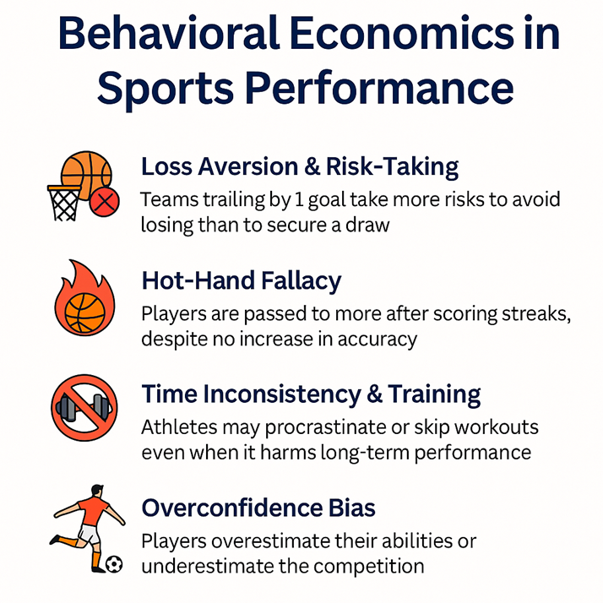

Slide 46
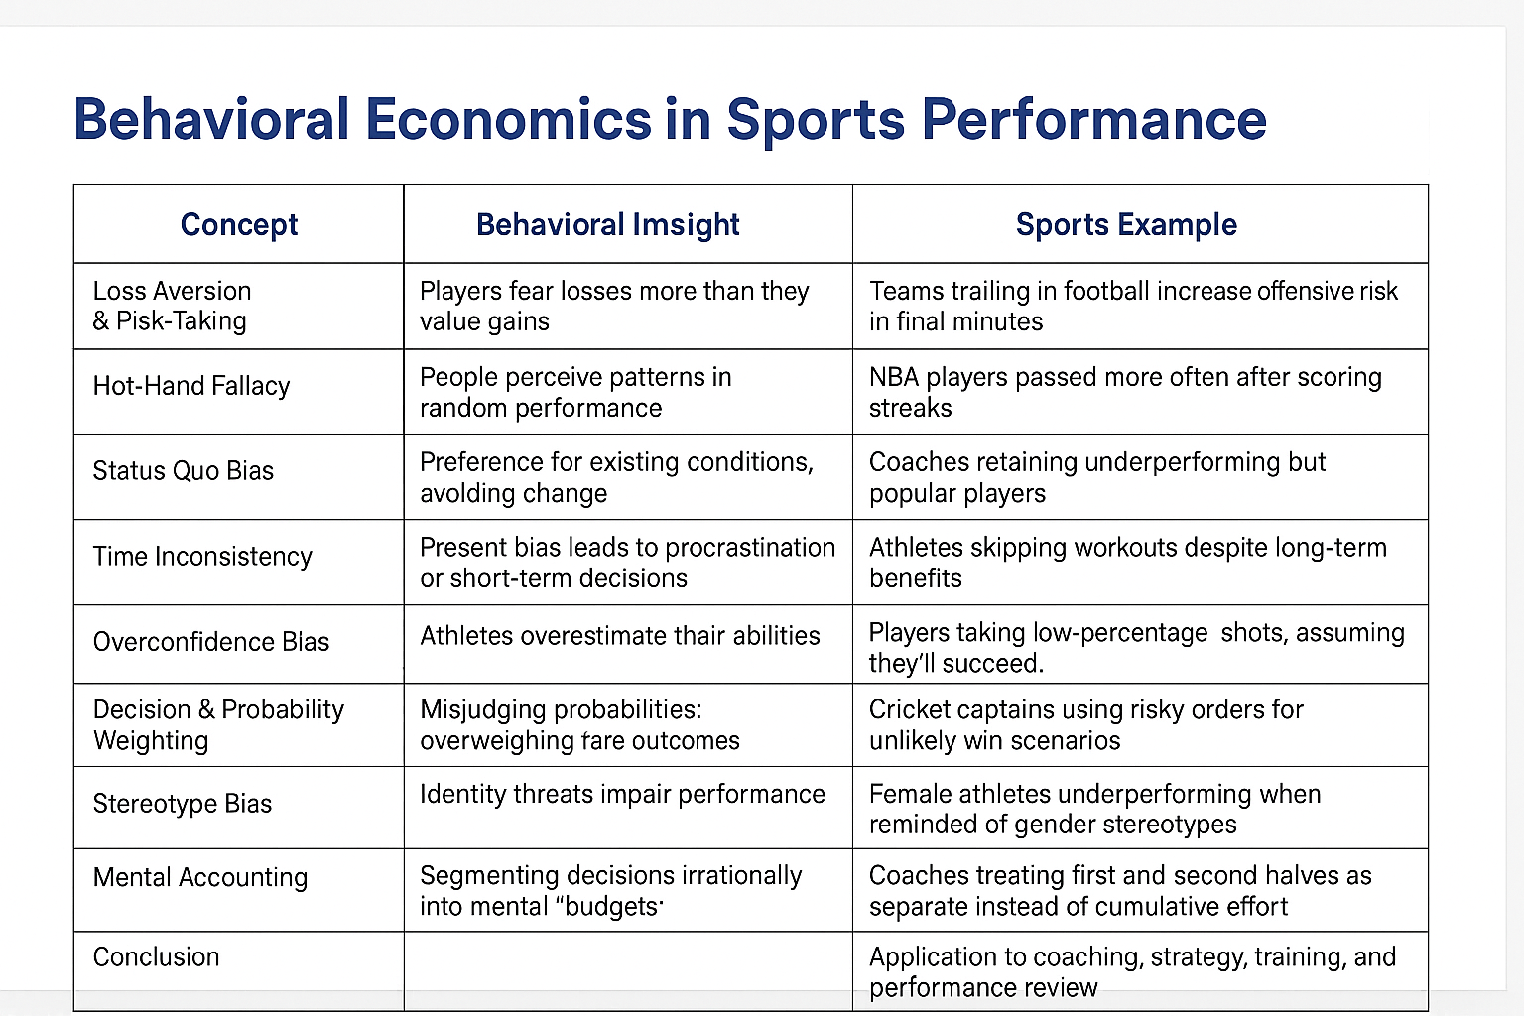

Slide 47
Geometric discounting
Geometric discounting assumes consistent preferences, real human behavior often shows time-inconsistent preferences. That's where behavioral economics suggests alternatives like hyperbolic discounting. Still, geometric discounting serves as a benchmark.

Slide 48
Geometric Vs Hyperbolic discounting
Aspect | Geometric Discounting | Hyperbolic Discounting
Discount factor | Constant over time | Declines sharply for near-future
Time consistency | Yes | No (present bias)
Rational decision model | Yes | No (psychologically realistic)
Example behavior | Always delay for better reward | Prefer smaller-sooner over larger-later

Slide 49
Instantaneous Utility
Instantaneous utility refers to the pleasure, satisfaction, or benefit that an individual derives from consuming a good or engaging in an activity at a particular moment in time.It’s the “right now” utility—distinct from overall lifetime or future utility.
Definition: The real-time pleasure or pain from consumption or activity.
Examples:
Reading a novel (positive utility)
Waiting in traffic (negative utility)
Applications:
Happiness tracking apps
Public transport comfort design

Slide 50



